Slide 1
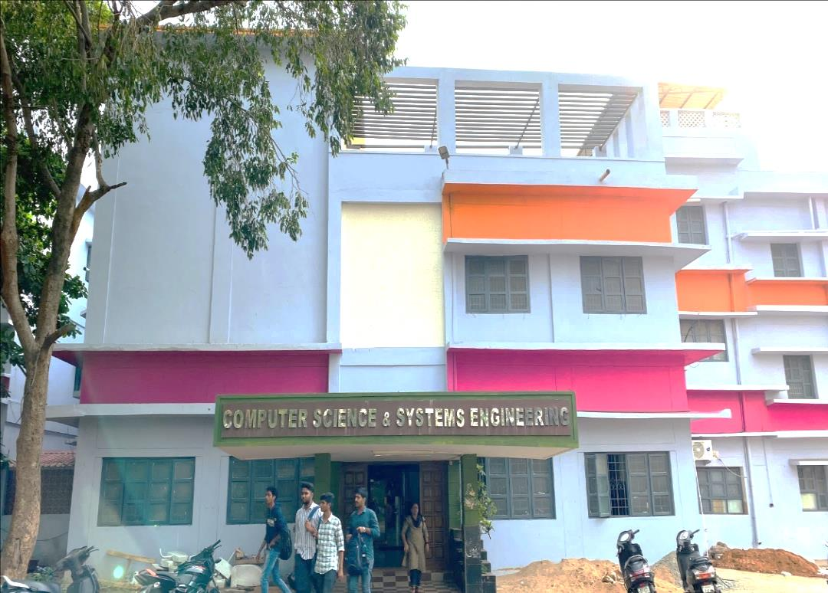
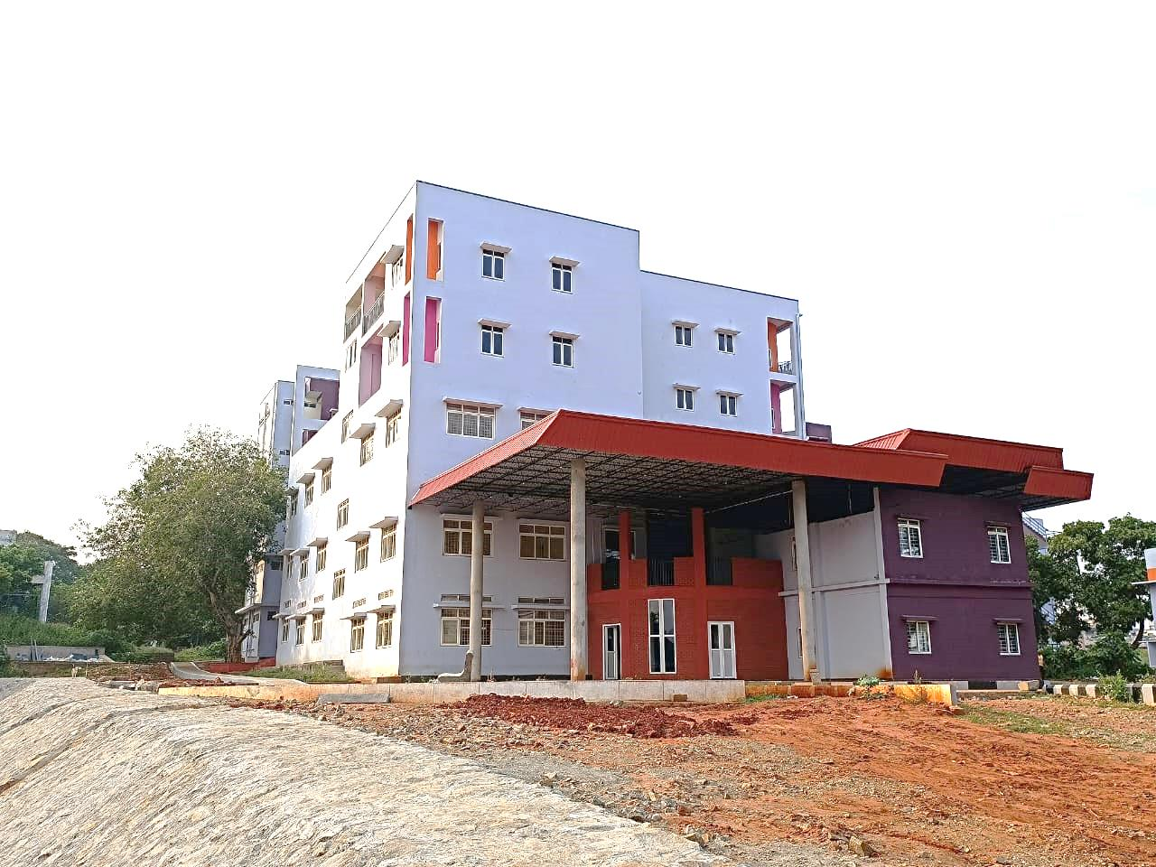
Department of Computer Science and Systems Engineering
Main Block
Algorithm Block

Slide 2
Department Vision and Mission
VISION
To facilitate
transformation of students into good human beings, competent professionals
focusing on assimilation, generation and dissemination of knowledge in the field of Computer Science and Engineering.

Slide 3
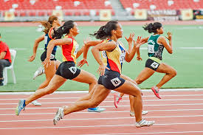
Department Vision and Mission
MISSION
Imparting quality education through well-designed curriculum in tune with the challenging needs of the industry and to develop innovative and ethical professionals fit for globally competitive environment.
Carry out Research and Development in Computer Science and Engineering and in leveraging state of the art technologies to serve the societal needs.
Developing effective interactions among faculty and students and foster networking with alumni, industries for mutual benefit.

Slide 4
Quality Policy
Excellence in teaching, research and consultancy by:
Imparting globally focused education
Creating world-class professionals
Establishing synergic relationships with Industry and Society
Developing state of the art infrastructure and well-endowed faculty
Imparting knowledge through teamwork and incessant efforts.

Slide 5
About the Department
Established in 1983
with UG, PG and Doctoral Programmes.
Four decades on, the department
has been the force for innovation, scientific discovery and global impact.
has state-of-the-art infrastructure and computing equipment supported by high speed network connectivity.
takes pride in its graduating students and many of them are leaders in academia, industry and government.
The primary focus is on
Improving teaching learning process.
Research and development of computational methods.
Providing innovative applications to contemporary problems.

Slide 6
About the Department
Accredited by NBA 3 times consecutively, the latest being for 6 years.
Faculty are actively engaged in research in the emerging technologies.
Artificial Intelligence, Machine Learning, Cyber security, IoT, Data Science and Computer vision.
The department is augmented with
experienced Adjunct & Honorary Professors and
Professor of Practice from IT industries
to meet the academia-industry gap.
The department attracts foreign students across the globe with different ethnic backgrounds and cultures.
The department offers skill oriented courses in collaboration with
Incubation and startup initiatives in the university (viz., ā-hub, DIGIFAC and Skill development center)
to equip the students with appropriate skill set in tune with industry needs.

Slide 7
Programmes Offered
Undergraduate Programmes
Postgraduate Programmes
S. No. | Programme Name
1. | B.Tech. Computer Science and Engineering
2. | B. Tech. + M.Tech. (Integrated) Computer Science and Engineering.
S. No. | Programme Name
1. | M.Tech. Computer Science and Technology
2. | M.Tech. Artificial Intelligence and Machine Learning
3. | M.Tech. Computer Networks and Information Security
Doctoral Programme
S. No. | Programme Name
1. | Ph.D. in Computer Science and Systems Engineering

Slide 8
UG & PG Scheme and Syllabus
Links to UG & PG Programmes Scheme and Syllabus
BTech-CSE-2021-22
BTech-CSE-2020-21
BTech-CSE-2019-20
BTech-CSE-2018-19
BTech-CSE-2017-18
M.Tech CST
M.Tech AI & ML
M.Tech CN & IS

Slide 9
Student Projects/Value added Courses/Internships
Project Works
B.Tech – 175
B.Tech+M.Tech-338
M.Tech - 337
Value added courses
20
Internships
114
Link to the documents
Link to the documents
Link to the documents
Student Project Works
Program name | 2017-18 | 2018-19 | 2019-20 | 2020-2021 | 2021-2022
B.Tech CSE | 40 | 26 | 37 | 32 | 40
B.Tech+M.Tech CSE - (Integrated) | 60 | 60 | 58 | 60 | 60
M.Tech CST | 29 | 27 | 31 | 24 | 17
M.Tech CST with specialization in AI&R | 16 | 11 | 13 | - | -
M.Tech AI&ML | - | - | - | 14 | 17
M.Tech CST with specialization in CN | 10 | 13 | 15 | - | -
M.Tech CN&IS | - | - | - | 16 | 14
M.Tech CST with specialization in BIO-Info | 14 | 14 | 16 | - | -
M.Tech IT | 13 | 13 | - | - | -
MCA | 39 | 36 | - | - | -
MSc. Computer Science | 28 | 33 | - | - | -

Slide 10
Value added Courses Conducted
Academic Year | No. of Value Added Courses | Name of the value added course | No. of Students benefited
2017-18 | 8 | One week Training program on Data Analytics with R | 495
 |  | R programming for Data Analytics
 |  | Machine Learning with R
 |  | One week workshop on Digital Forensics and Investigation Tools
 |  | Machine Intelligence with R
 |  | Data Analytics for Cyber Security
 |  | Internship and skill development workshop
 |  | IOT Boot Camp
2018-19 | 5 | Cyber Security Tools and Forensic Methods | 225
 |  | Internship Programme on Application Development using Java and Mean stack
 |  | Enhancing employability Skills for Engineering students held at Computer Science Department.
 |  | Employability Skills for Computer Engineering Students
 |  | Block Chain & Cyber Security
2019-20 | 1 | Data Science with python | 150
2020-21 | 3 | Block Chain & Cyber Security | 225
 |  | Cyber Security & Penetration Testing
 |  | Vulnerability Assessment and Malware Analysis
2021-22 | 3 | Database Administration Fundamentals | 602
 |  | HTML5 Application Development Fundamentals
 |  | Introduction to Programming using Python

Slide 11
Feedback on Curriculum

Slide 12
Feedback on curriculum
Student Feedback on curriculum- 69
Parent Feedback on curriculum- 108
Faculty Feedback on curriculum- 30
Alumni Feedback on curriculum- 11
Employer Feedback on curriculum-15

Slide 13
Student Demand Ratio
B.Tech Computer Science and Engineering
Academic Year | 2017-18 | 2018-19 | 2019-20 | 2020-21 | 2021-22
Students Admitted | 32 | 48 | 88 | 87 | 79
Applications Received | 145428 | 132281 | 133003 | 133072 | 133072
Demand Ratio | 1:4545 | 1:2756 | 1:1511 | 1:1530 | 1:1685
M.Tech CST
Academic Year | 2017-18 | 2018-19 | 2019-20 | 2020-21 | 2021-22
Students Admitted | 29 | 27 | 31 | 24 | 17
Applications Received | 26677 | 23831 | 20986 | 20165 | 20165
Demand Ratio | 1:920 | 1:883 | 1:677 | 1:840 | 1:1186
 | M.Tech AI & ML |  | M.Tech CN&IS
Academic Year | 2020-21 | 2021-22 | 2020-21 | 2021-22
Students admitted | 14 | 17 | 16 | 14
Applications Received | 20165 | 20165 | 20165 | 20165
Demand ratio | 1:1440 | 1:1186 | 1:1260 | 1:1440
‹#›

Slide 14
Seats Filled Under Reserved Categories

Slide 15
Student Diversity

Slide 16
Student Faculty Ratio
 | Number of Students
Programmes | 2017-18 | 2018-19 | 2019-20 | 2020-21 | 2021-22
B.Tech Computer Science Engineering | 135 | 143 | 205 | 255 | 302
B.Tech Computer Science Engineering | 238 | 236 | 241 | 243 | 252
M.Tech Computer Science and Technology | 59 | 56 | 58 | 55 | 41
M.Tech CST with Artificial Intelligence and Robotics | 28 | 27 | 24 | - | -
M.Tech CST with Computer Networks | 21 | 23 | 28 | - | -
M.Tech Artificial Intelligence and Machine Learning | - | - | - | 27 | 31
M.Tech Computer Networks and Information Security | - | - | - | 31 | 30
M.Tech CST with Bioinformatics | 27 | 28 | 30 | 16 | -
M.Tech Information Technology | 26 | 26 | - | - | -
M.Sc. Computer Science | 60 | 61 | - | - | -
MCA Master of Computer Applications | 80 | 75 | - | - | -
Total strength | 674 | 675 | 586 | 627 | 656
Faculty | 48 | 48 | 42 | 45 | 47
SFR | 14 | 14 | 14 | 14 | 14

Slide 17
Curricular Aspect – Outcome Based Education
OBE Framework
Identification of extent of compliance
POs mapping with curriculum
Mapping of all the COs with POs
Determining the extent of correlations between CO-PO
Alumni Feedback
Process used to identify extent of compliance of the University Curriculum for attaining the POS and PSOS
Curriculum Gap Identification
Faculty Input
Industry Feedback
Parents Feedback

Slide 18
PEOs & PSOs
B.Tech CSE & B.Tech+M.Tech CSE (Integrated)
Programme Educational Objectives (PEOs) | Description
PEO1 | Apply Concepts of Computer Science blended with mathematics and engineering to model computing systems
PEO2 | Based on requirement specifications, Design, implement, test and maintain software systems.
PEO3 | Communicate effectively with team members, engage in applying technologies and lead teams in industry
PEO4 | Assess the Systems from quality, security, privacy, cost, utility, etiquette and ethics view point
PEO5 | Adapt to changing professional and societal needs by engage in lifelong learning, and career enhancement.
Program Specific Outcomes (PSOs) | Description
PSO1 | An ability to design hardware and software in emerging technology environments like embedded products and secure systems with new ideas
PSO2 | An ability to demonstrate basic knowledge of Database System, Software Engineering, Computer Networking and Operating System for software applications.
PSO3 | An ability to design & develop program, algorithms and complete projects using open source tools and efficient data structures

Slide 19
POs
B.Tech CSE & B.Tech+M.Tech CSE (Integrated)
Program Outcomes (POs) | Description
PO 1 | Able to apply knowledge of computing, mathematics, & engineering principles.
PO 2 | Able to identify, formulate, and solve complex computer science & engineering problems
PO 3 | Able to design, implement, and evaluate a computer-based system, component, process or program to meet desired needs with appropriate considerations such as economic / environmental.
PO 4 | Able to design and conduct experiments, as well as to analyze and interpret data in computer science & engineering.
PO 5 | Able to use the techniques, skills, and modern engineering & computational tools necessary for computer science & engineering practices.
PO 6 | Understand the impact of contextual knowledge on social and cultural issues.
PO 7 | Understand contemporary issues related to social & environmental context for sustainable development of engineering solutions.
PO 8 | Understand professional & ethical responsibility.
PO 9 | Able to function effectively as an individual, as a member or leader in diverse & multidisciplinary teams.
PO 10 | Able to communicate effectively with teams.
PO 11 | Understand engineering & management principles to manage projects.
PO 12 | Recognize the need for, with an ability to engage in lifelong learning.

Slide 20
CO-PO mapping
CO-PO Mapping for Database Management System
 |  |  | PO1 | PO2 | PO3 | PO4 | PO5 | PO6 | PO7 | PO8 | PO9 | PO10 | PO11 | PO12
Database Management System | CS 2203 | CO1 | 3 | 3 | 3 | 3 | 3 | 2 | 2 | 2 | 1 | 1 | 2 | 2
 |  | CO2 | 3 | 3 | 3 | 3 | 3 | 2 | 2 | 2 | 1 | 1 | 2 | 1
 |  | CO3 | 3 | 3 | 3 | 3 | 3 | 1 | 1 | 2 | 1 | 1 | 2 | 1
 |  | CO4 | 3 | 3 | 3 | 3 | 3 | 2 | 2 | 2 | 1 | 1 | 2 | 1

Slide 21
PO Attainment
PO-Attainment for DBMS |  |  |  |  |  |  |  |  |  |  |  |  |  | OVERALL ATTAINEMNT
 |  | PO1 | PO2 | PO3 | PO4 | PO5 | PO6 | PO7 | PO8 | PO9 | PO10 | PO11 | PO12 | 2.04
DBMS | CO1 | 2.85 | 2.85 | 2.85 | 2.85 | 2.85 | 1.90 | 1.90 | 1.90 | 0.95 | 0.95 | 1.90 | 1.90
 | CO2 | 2.85 | 2.85 | 2.85 | 2.85 | 2.85 | 1.90 | 1.90 | 1.90 | 0.95 | 0.95 | 1.90 | 0.95
 | CO3 | 2.85 | 2.85 | 2.85 | 2.85 | 2.85 | 0.95 | 0.95 | 1.90 | 0.95 | 0.95 | 1.90 | 0.95
 | CO4 | 2.85 | 2.85 | 2.85 | 2.85 | 2.85 | 1.90 | 1.90 | 1.90 | 0.95 | 0.95 | 1.90 | 0.95
Average |  | 2.85 | 2.85 | 2.85 | 2.85 | 2.85 | 1.66 | 1.66 | 1.90 | 0.95 | 0.95 | 1.90 | 1.19

Slide 22
Overall PO Attainment
Overall PO attainment for 2019-20 admitted batch
S.NO | POS | Direct Attainment | Indirect Attainment | Direct Attainment(80%) | Indirect Attainment(20%) | Overall PO Attainment
1 | PO1 | 2.7 | 2.8 | 2.1 | 0.6 | 2.7
2 | PO2 | 2.8 | 2.4 | 2.2 | 0.5 | 2.7
3 | PO3 | 2.3 | 2.8 | 1.8 | 0.6 | 2.4
4 | PO4 | 2.4 | 2.8 | 1.9 | 0.6 | 2.4
5 | PO5 | 2.2 | 2.3 | 1.8 | 0.5 | 2.2
6 | PO6 | 2.5 | 2.8 | 2.0 | 0.6 | 2.5
7 | PO7 | 1.7 | 2.8 | 1.3 | 0.6 | 1.9
8 | PO8 | 1.7 | 2.1 | 1.4 | 0.4 | 1.8
9 | PO9 | 2.3 | 2.3 | 1.8 | 0.5 | 2.3
10 | PO10 | 2.0 | 2.8 | 1.6 | 0.6 | 2.1
11 | PO11 | 2.1 | 2.8 | 1.7 | 0.6 | 2.2
12 | PO12 | 1.8 | 2.1 | 1.4 | 0.4 | 1.8

Slide 23
Pass Percentage
B.Tech & B.Tech+M.Tech | Total Number Attended | Total Number Passed
2017-18 | 101 | 93
2018-19 | 86 | 81
2019-20 | 95 | 95
2020-21 | 92 | 92
2021-22 | 121 | 120
M.Tech | Total Number Attended | Total number passed
2017-18 | 55 | 49
2018-19 | 59 | 56
2019-20 | 65 | 65
2020-21 | 62 | 62
2021-22 | 51 | 48

Slide 24
Student Categorization – Advanced Learners & Slow Learners
Programs For Advanced Learners
Encouraged to attend workshops, seminars, Hackathons and Coding competitions.
Assisted in Resume building and Technical skilling programs.
Motivated to attend NPTEL, SWAYAM, MOOC courses, Coursera to gain advanced skills.
Advanced learners: who scored more than 80%.
Slow learners: who scored below 50% and failed students
For 2018-2022 batch
During Academic Year | No. of Students (Advanced Learners)
2018-19 | 11
2019-20 | 09
2020-21 | 13
2021-22 | 13
Programs For Slow Learners
Remedial classes
Assignments and handouts
Regular monitoring and Counselling.
During Academic Year | No. of Students (Slow Learners)
2018-19 | 09
2019-20 | 08
2020-21 | 03
2021-22 | 02

Slide 25
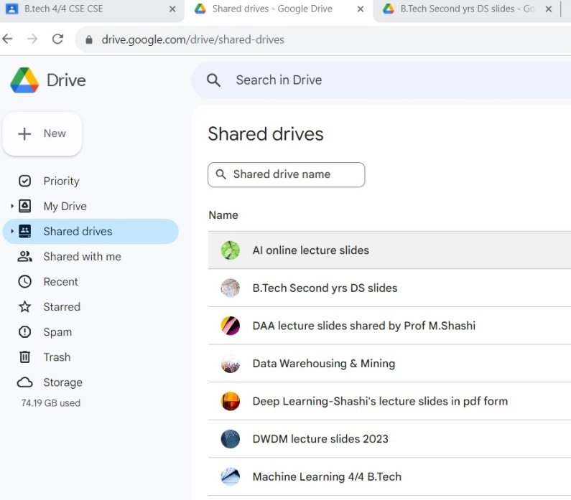
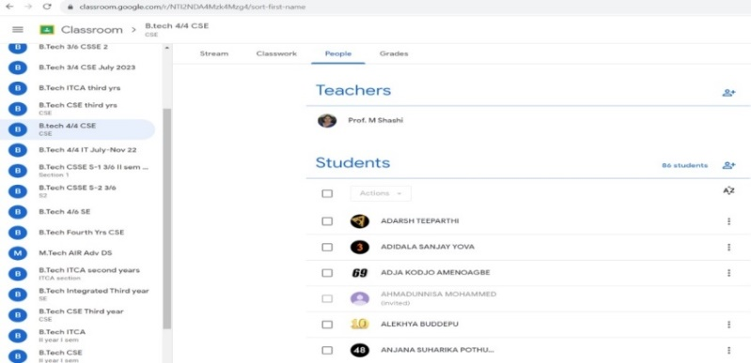
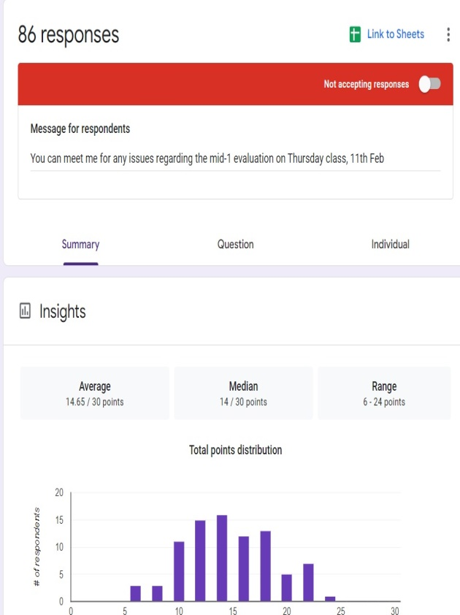
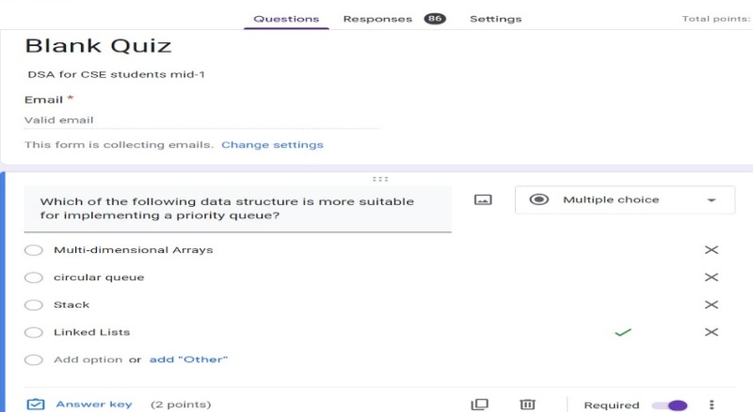
Student Centric Methods
The following student centric blended learning methods are used:
Google Classroom: used as Blended Learning Platform
Google Forms : used to conduct MCQ quizzes online
Participative Learning: Microsoft Up Skilling programme was conducted for 529 students.
Educational Videos and animations: Youtube videos are provided.
Smart Classrooms: All Classrooms enabled with Smart boards.
e-Resources: e- journals are provided through IEEE and DELNET.

Slide 26
Student Support and Progression
S. No | Name of the scholarship | No. of students benefited | Amount granted per year | Academic year
1 | A.P. Govt. Scholarships | 1418 | ₹ 5,85,75,892 | 2017-2022
2 | UGC/CSIR/NET Fellowships | 06 (SRF’s) | ₹ 29,23,200 | 2018-2023
 |  | 02 (JRF’s) | ₹ 8,90,880 | 2021-2024
3 | Visvesarayya Fellowships | 04 | ₹ 85,92,000 | 2017-2022
4 | Other Scholarships such as CISF, BSNL, ONGC, North South Foundation, Railway and etc., | 73 | ₹ 14,52,000 | 2019-2022

Slide 27
Student Support and Progression
During 2018-2019
Events :3
Participants:740
Duirng 2018-19
Events :1
Participants:300
Workshops on Enhancing Employability skills
Workshop on IB Hubs and Boot camp
Seeghra-Tanthra : 2 days National Hackathon
IoT Workshop
During 2018-19
Events :1
Participants: 50
During 2022-23
Events :1
Participants: 40

Slide 28
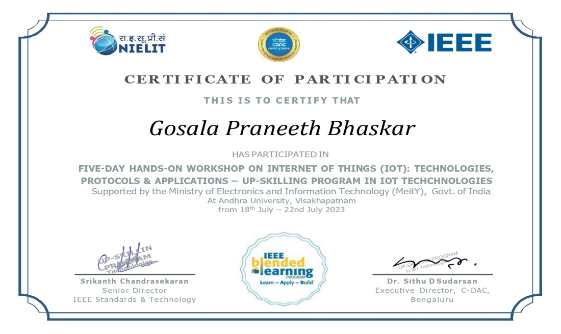
Student Support and Progression
Up-skilling program in “IoT Technologies” to SC/ST category students has been organized by
C-DAC in collaboration with IEEE.
The program has helped candidates to upskill their technical knowledge to become industry-ready.
Candidates have received joint certificate from IEEE and C-DAC upon the successful completion of learning and assessment.

Slide 29
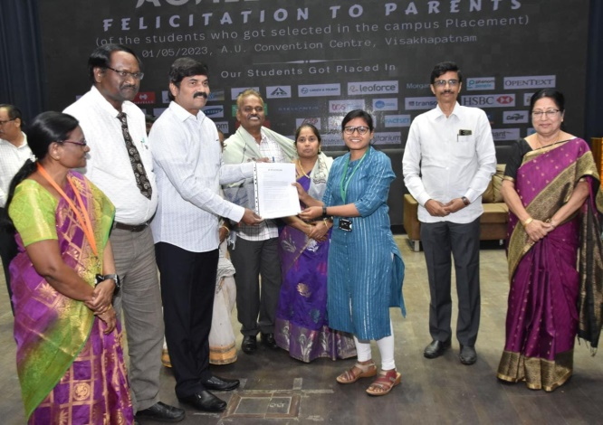
Student Support and Progression
Eswari Priya Repaka got placed in Atlassian with 84.5 LPA in Nov-2022

Slide 30
Faculty Details
S. No. | Name of the faculty | Designation | Qualification | Total Teaching/ Industry Experience | Specialization
1 | Prof.Prasad Reddy P.V.G.D | Senior Professor & Honorable Vice-Chancellor, Andhra University | Ph.D | 36 | Software Architectures, Data Engineering, Image Analysis, Machine Intelligence, Computer Networks and Crypto Systems &Web Technologies
2 | Prof M Shashi | Professor & Faculty Chairman ,AU College of Engineering | Ph.D | 38 | Data Warehousing and Mining, Artificial Intelligence, Machine learning and Deep Learning.
3 | Prof V Valli Kumari | Professor | Ph.D | 31 | Machine Learning, Gen AI and Cyber Security
4 | Prof .Nageswara Rao Kuda | Professor | Ph.D | 25 | Communication Networks, Cyber Security, Cloud Computing and IoT
5 | Prof D Lalitha Bhaskari | Professor and BoS Chairman department of CS&SE | Ph.D | 25 | Security, Theory of Computation, Image Processing, Network Security and Cryptography.
6 | Prof. K Venkata Rao | Professor and Head of the Department of CS&SE & Coordinator-RUSA,A.U | Ph.D | 28 | Image Processing, Natural Language Processing, Network & Security Issues, IOT and Machine Learning.
7 | Prof. Bodapati Prajna | Professor | Ph.D | 21 | Data Mining and Machine Learning
8 | Prof S Viziananda Row | Professor | Ph.D | 36 | Image Analysis, Computer Vision and Artificial Intelligence.
9 | Prof Ch SatyanandaReddy | Professor | Ph.D | 21 | Software Engineering, Software Project and Process Management ,Human Computer Interaction and Data Engineering.

Slide 31
Faculty Details
10 | Prof. P. Seetharamaiah | Professor (Emeritus) | Ph.D | 40 | Embedded Systems and Robotics
11 | Prof. K. Venkata Ramana | Professor (Honorary) | Ph.D | 36 | Computer Vision and Image Processing
12 | Prof. M.S. Prasad Babu | Professor (Honorary) | Ph.D | 40 | Artificial Intelligence, Machine Learning, IOT and Big Data Analytics
13 | Prof. K. Venkateswarlu | Professor (Adjunct) | Ph.D | 33 | Algebra – Ordered Structures, Rings-lattices-Boolean Algebra
14 | Dr. Bharati Bidikar | Professor (Adjunct) | Ph.D | 10 | Global Positioning System, Electronics and Communication Engineering
15 | Dr. S. Raja | Professor (Adjunct) | Ph.D | 42 (Industry in DRDO) | Embedded Systems and Real Time Systems
16 | Dr. S. Lakshminarayana | Professor (Adjunct) and Officer on Special Duty | Ph.D | 38 (Industry in NIO and AICTE) | Data Mining and Artificial Intelligence
17 | Dr. I. S. Srinivasa Rao | Professor (Adjunct) | M.Tech (Ph.D) | 20 | Information Technology, Wireless Body Area Networks
18 | Prof. P. Sanyasi Naidu | Professor (Ad-Hoc) | Ph.D | 28 | Information Security
19 | Dr. G. Sandhya Devi | Professor (Ad-Hoc) | Ph.D | 14 | Machine Learning and Image processing
20 | Prof. Ch. Narasimham | Chair Professor (IOCL) | Ph.D, D.Sc (Engg.) | 30 | Network Security, Cryptography, Cloud Computing and Block Chain Tech. Security
21 | Dr. P. Rama Raju | Professor of Practice | Ph.D | 20 (IT Industry) | Data Science & Artificial Intelligence

Slide 32
Faculty Details
22 | Mr. M. Giridhar Patnaik | Professor of Practice | M.Tech (CS &AI) | 17 | Neural Networks and Artificial Intelligence Semi-Conductor and Biomedical Devices
23 | Mr. B. Sai Ram | Professor of Practice | M.Sc-(CS) EGMP, IIMB | 32 (IT Industry) | Software Engineering, Software Project Management, Outsourcing & Data Engineering
24 | Dr. K. Raja Kumar | Associate Professor | Ph.D | 21 | Embedded Systems, IOT, Vehicular Networks and Machine Learning.
25 | Dr. S. Jhansi Rani | Associate Professor | Ph.D | 21 | Image Processing, Networking & Machine Learning.
26 | Dr. K .Venkata Ramana | Associate Professor | Ph.D | 19 | Data Engineering and Security
27 | Dr. A. Mary Sowjanya | Associate Professor | Ph.D | 18 | Data Mining, Machine Learning and Natural Language Process.
28 | Dr. G. Lavanya Devi | Assistant Professor | Ph.D | 22 | Machine Learning , Bio-Informatics and Soft Computing
29 | Dr. G. Sharmila Sujatha | Assistant Professor (Contract) | Ph.D | 22 | Image Processing , Data mining and Data Warehouse

Slide 33
Faculty Details
30 | Mrs. L. Yamini Swathi | Assistant Professor (Contract) | M.Sc, M.Phil Pursuing Ph.,D | 18 | Computer Organization & Architecture ,Micro Processor and Digital Logic Design
31 | Mrs. N. Padmaja Lavanya Kumari | Assistant Professor (Contract) | AMIE, M.Tech Ph.D (Submitted) | 18 | Computer Organization & Architecture , Data Communication and Computer Networks .
32 | Smt. K.S.S. Soujanya Kumari | Assistant Professor (Contract) | M.Sc, M.Phil, Pursuing Ph.,D | 18 | Computer Organization & Architecture and Micro Processor.
33 | Mr. M. Bala Naga Bhushanam | Assistant Professor (Contract) | M.S, Pursuing Ph.,D | 18 | Artificial Intelligence, Computer Organization & Architecture , Embedded Systems and Digital Image Processing.
34 | Mrs.S. Priyanka | Assistant Professor (Ad-Hoc) | M.Tech(CST), Pursuing Ph.D | 7 | Machine learning
35 | Ms. Shweta Balakrishna Ramteke | Assistant Professor (Ad-Hoc) | M.Tech(CSE), | 5.5 | Microprocessor, Web technologies and Artificial Intelligence &IOT
36 | Mr D. Paul Joseph | Assistant Professor (Ad-Hoc) | M.Tech ,Ph.D | 7 | Cyber Security, Digital Forensics and Natural Language Processing
37 | Mr. B.J.M. Ravi Kumar | Assistant Professor (Ad-Hoc) | M.Tech | 21 | Machine Learning and Database Management Systems.

Slide 34
Faculty Details
Retention Rate: 100%
Average SFR: 1:14
4
5
9
Average Experience: 24 years
1
4
14

Slide 35
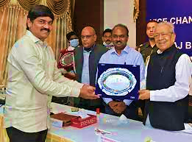
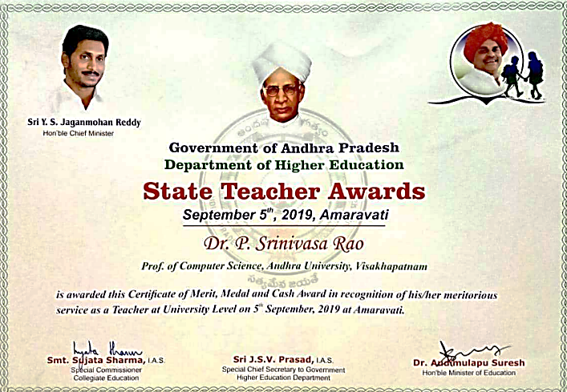
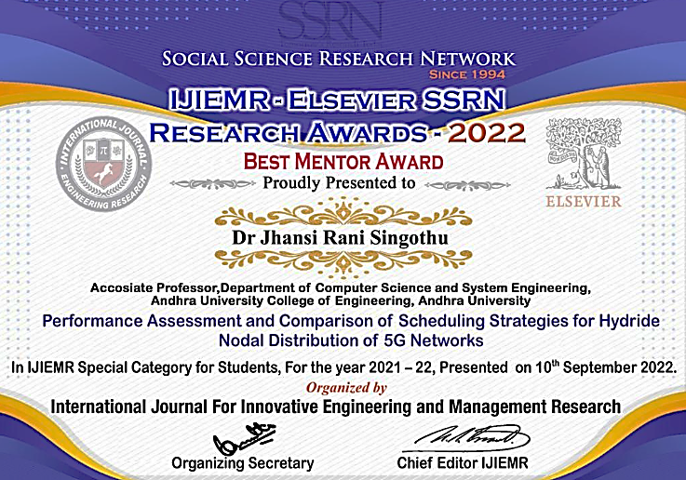
Faculty Awards and Achievements
Prof. P.V.G.D Prasad Reddy
Excellence Award
Vice-Chancellors conference at Raj Bhavan on 5th May, 2022
Prof. P. Srinivasa Rao
State Teacher Awards-2019
Government of Andhra Pradesh Awarded on 5th September,2019
Dr. S. Jhansi Rani
Best Mentor Award,
SOLETE, Awarded on 10th September,2022
Prof. P.V.G.D Prasad Reddy
Excellence Award
Vice-Chancellors conference at Raj Bhavan on 5th May, 2022
Prof. P. Srinivasa Rao
State Teacher Awards-2019
Government of Andhra Pradesh

Slide 36
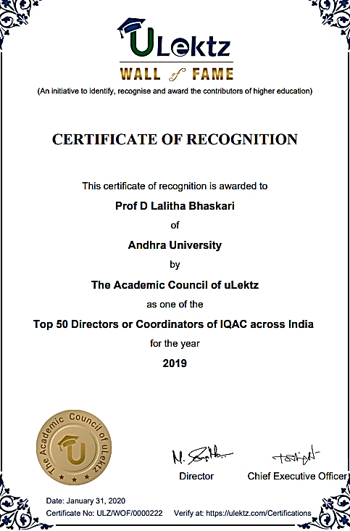
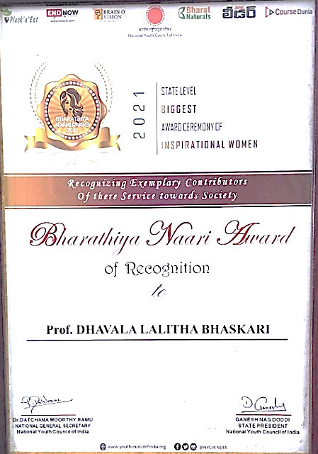
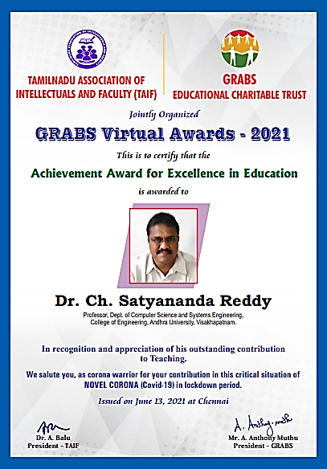
Faculty Awards and Achievements
Prof. D. Lalitha Bhaskari
Top 50 Directors or Coordinators of IQAC across INDIA-2019
Prof. D. Lalitha Bhaskari
Bharateeya Naari Award
National youth council of India, Telangana-2021
Prof. Ch. Satyananda Reddy
Achievement Award for Excellence in Education,
GRABS Virtual Awards - 2021

Slide 37
Faculty Research Activity
S.No | Name of the Faculty | No. of Publications | No. of Patents | PhDs Awarded
1. | Prof. P. V. G. D. Prasad Reddy | 41 | 03 | 11
2. | Prof. M. Shashi | 28 | 01 | 10
3. | Prof. V. Valli Kumari | 24 | 02 | 12
4. | Prof. Kuda Nageswara Rao | 03 | - | 04
5. | Prof. D. Lalitha Bhaskari | 52 | 01 | 08
6. | Prof. K. Venkata Rao | 57 | - | 07
7. | Prof. B. Prajna | 01 | 01 | 02
8. | Prof. S. Viziananda Row | 06 | - | -
9. | Prof. Ch. Satayananda Reddy | 33 | 03 | 02
10. | Prof. Kunjam Nageshwara Rao | 32 | 03 | 02
11. | Dr. K. Raja Kumar | 20 | 01 | 04
12. | Dr. S. Jhansi Rani | 35 | 05 | 03
13. | Dr. K. Venkata Ramana | 32 | 02 | 04
14. | Dr. A. Mary Sowjanya | 28 | 04 | 05
15. | Dr. G. Lavanya Devi | 43 | - | 13

Slide 38
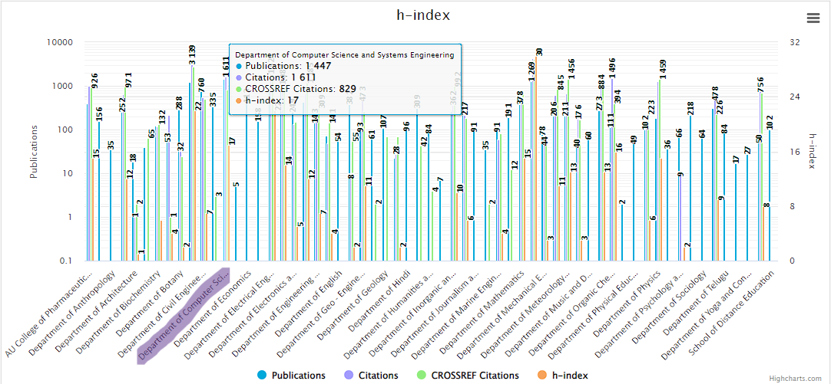
Research Activity
1447 publications, 1611 citations, with a SCOPUS h-index of 17.

Slide 39
Financial Support from Funding Agencies
S.no | Name of the Scheme/Project/ Endowments/ Chairs | Name of the Principal Investigator/ Co Investigator (if applicable) | Name of the Funding agency | Year of Award | Funds provided (INR in lakhs) | Duration of the project
1 | Information security Education and Awareness (ISEA) Project Phase -II | Prof. M. Shashi | ISEA | 2017 | 26.00 | 2017-22
2 | Multi Centric Clinical Trails of Indian Cochlear Implant System | Prof P. Seetharamayya | DRDO INDIA | 2018 | 7.80 | 2018-19
3 | Society for Biomedical Technology | Prof P.Seetharamayya | ISRO, BANGALORE | 2019 | 39.00 | 2019-24
4 | Cyber Security and incident Analysis | Prof. V. ValliKumari | AICTE, New Delhi | 2021 | 0.93 | 2021
5 | Fostering Start-up, Innovation and Enterpreneurship | Sri. Ravi Eswarapu | AICTE | 2021 | 0.93 | 2021

Slide 40
Financial Support from Funding Agencies
S.no | Name of the Scheme/Project/ Endowments/ Chairs | Name of the Principal Investigator/ Co Investigator (if applicable) | Name of the Funding agency | Year of Award | Funds provided (INR in lakhs) | Duration of the project
6 | Deep learning Approach to Abstract Summarization of Text Documents using Python | Prof. M. Shashi | EXAWIZARDS | 2017 | 6.00 | 2017-18
7 | Transfer learning for Natural Language Processing | Prof. M. Shashi | EXAWIZARDS | 2018 | 2.20 | 2018-19
8 | MRI Coronary Artery Detection applying Deep Learning Techniques | Prof. D. Laltha Bhaskari | EXAWIZARDS | 2017 | 5.00 | 2017-18
9 | Improving Semantics segmantation model Accuracy using MSCOCO and pascalVOC dataseta | Prof. D. Laltha Bhaskari | EXAWIZARDS | 2018 | 2.50 | 2018-19
10 | Young Faculty Research Fellowship | Dr. G. Lavanya Devi | Digital India Corporation | 2018 | 7.40 | 2018-23
11 | Young Faculty Research Fellowship | Dr. A. Mary Sowjanya | Digital India Corporation | 2018 | 7.40 | 2018-23

Slide 41
Financial Support for FDP
Name of the Faculty | Name of conference/ workshop attended for which financial support provided | A.Y. | Amount (Rs.)
Prof. D. Lalitha Bhaskari | Faculty Development Program (FDP) on "Data Science & its Applications in STEM" | 2020-21 | 68,000
Dr. K. Raja Kumar | Computer Architecture subject as a part of twining activity of TEQIP III held at G.B Pant Institute of Engineering and Technology, Pauri Garhwal, Uttarakhand. | 2019-20 | 26,216
Prof. Kuda Nageswara Rao | A Five day residential training programme on "Knowledge Management" Conducted by Jaipur Productivity Centre held at Mussoorie | 2019-20 | 53,100
Prof. D. Lalitha Bhaskari | SPARL by UGC at Bangalore 20-09-2019 | 2019-20 | 18,060
Dr. Kunjam Nageswara Rao | SLA Orientation workshop at AICTE , New Delhi | 2018-19 | 16,009
Prof. P. Srinivasa Rao | One Day Workshop on Examination Reforms organized by AICTE at JNTU Hyderabad on 11-01-2019 | 2018-19 | 16,206
Prof. V. Valli Kumari | Information Security Internal Audit Ghaziabad (Near Delhi) | 2018-19 | 53,032
Prof. M. S. Prasad Babu | Attended "Good governance summit at AICTE, Auditorium, New Delhi on 23rd January 2018 | 2018-19 | 33,704

Slide 42
Memorandum of Understandings
Academic partnership programme with world class institutes like The University of Western Australia and BTH, Sweden
27 students have pursued their B.Tech (3+1) Programme at AU and BTH during the academic years 2017-22.
Four Chair Professors have been instituted by the industries under university industry partnership:
IOCL, India. Symbosis, India
Unyte Inc., USA SPECTRAFORCE, USA
Consultancy partnership with EXAWIZARDS, Tokyo, Japan, in the area of AI&ML involving our faculty and research scholars
5 consultancy projects have been successfully completed.
• Academic partnership programme with DIGIFAC Pvt. Ltd. Visakhapatnam to provide training programmes, internships and placements to the department students, Dec-2022.
125 candidates were trained in LOWCODE and 1 candidate placed so far
Academic partnership program with Tech Mahindra, Pvt. Ltd., Visakhapatnam
which has provided internship cum projects for 150 students during Academic years 2017-2022

Slide 43
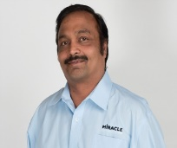
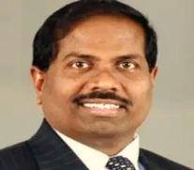
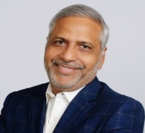
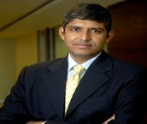
Illustrious Alumni
Sri Prasad Lokam
CEO/President, Miracle Software System
Dr. Srinivas Kishan Anapu
CEO,
Yxiom Technologies Pvt. Ltd
Sri T. Divakar
CEO/President, Chairman Innominds software
Sri Anil Kothuri
President, Edeweiss Financial Services Ltd
Sri K. Chandra | CEO, SPM Strategies, CA.
Sri Hari Krishna Burle | Vice President (BLR), WIPRO Technologies
Sri P. Shyam | Director, Evoce.
Sri R.V.V.S.N. Murthy | Director, Intuitive Surgical.
Sri M.S.V. Raghava Prasad | Director, Oracle India ltd, Bangalore.
Sri K. Giri | Director of Engineering, Cipher Cloud, India
Sri D. Udaya Kumar | Executive Director, AT&T

Slide 44
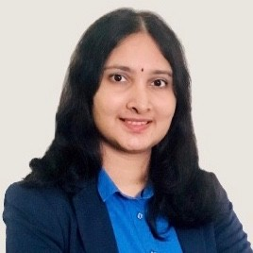
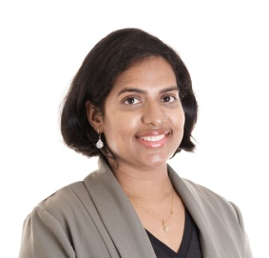
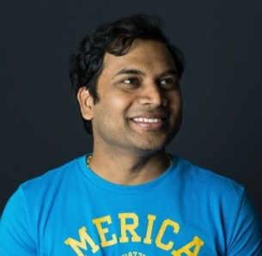
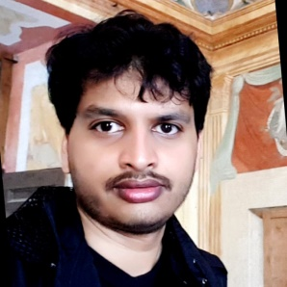
Illustrious Alumni
Smt. D. Manogna Principal Data Modeller, PMP, SAFe, POPM,
Australia
Dr. G.Anitha, Assistant Professor, University of Massachusetts Lowell, USA
Dr. M.Lakshmi narayana
Technical Lead in Siri, AI/ML Org, Apple,USA
Dr. G.Taraka Ram, Postdoctoral Researcher in Computer Science Department, Carnegie Mellon University, USA
Dr. Praveen Yedlapalli | Technical Leader in Nutanix R&D, USA
Dr. D.Janardhan Rao | Huie-Rogers Endowed Chair,Associate Professor of Computer Science at Washington,State University

Slide 45
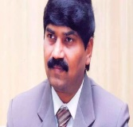
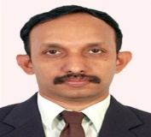
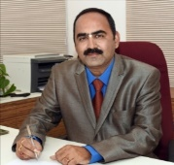
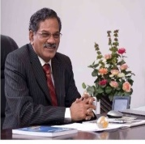
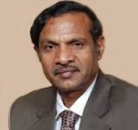
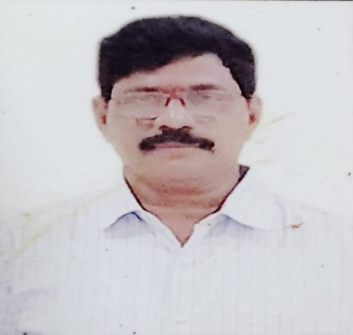
Illustrious Alumni
Prof. PVGD Prasad Reddy,
Vice-Chancellor,
Andhra University
Dr. Abraham Varughese, Director, NSTL
Dr. G.P.S. Varma Vice-Chancellor, KLU
Prof. A. Appa Rao (Late), Former Vice-Chancellor, JNTUK
Prof. Beela Satyanaryana
Former Vice-Chancellor, AU
Sri A. Ramachandra Murthy
Special Collector,Dr.KLRao Sagar Project, Palnadu

Slide 46
Alumni Contributions
Year | Sponsored by | Purpose | Amount
2017-2018 | M.Tech (2001,2002 & 2012 Batches) | Steel Sitting Chairs, Automatic RO water purifier, Automatic water cooler | Rs.10,50,000
2018-2019 | B.Tech (1987 & 2005 Batches) M.Tech (1998 &2016 Batches) | Ground water facility Parking in front of the Department Mineral-Drinking water plant Software Lab Infrastructure | Rs.19,00,000
2019-2020 | M.Tech (2012 Batch) MCA (2008 Batch) | Toilets & Restrooms Fans in Ground floor entrance | Rs. 5,50,000

Slide 47
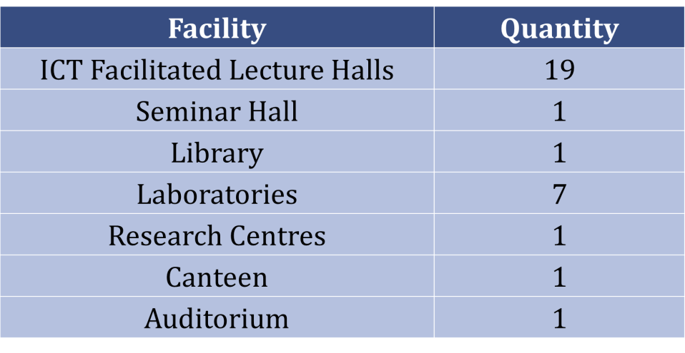
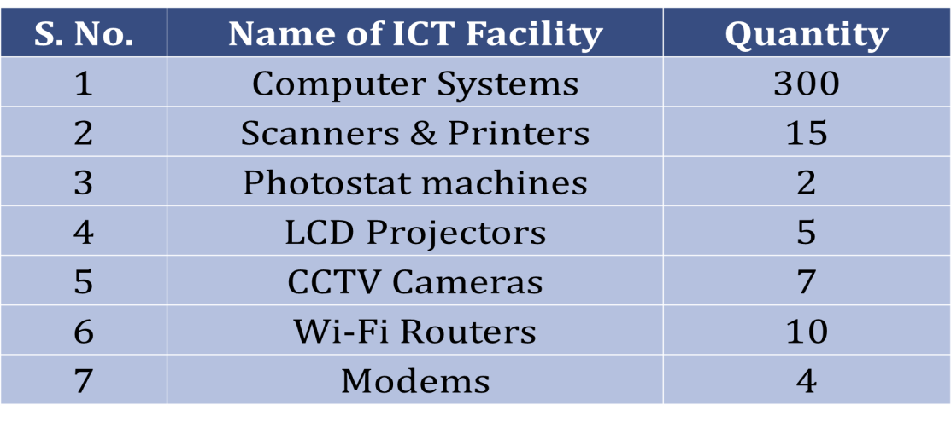
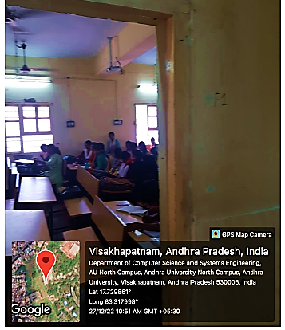
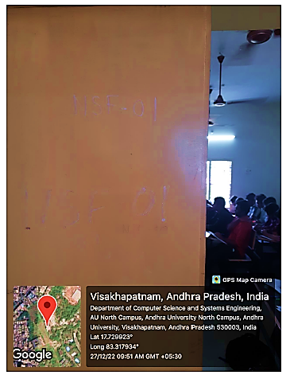
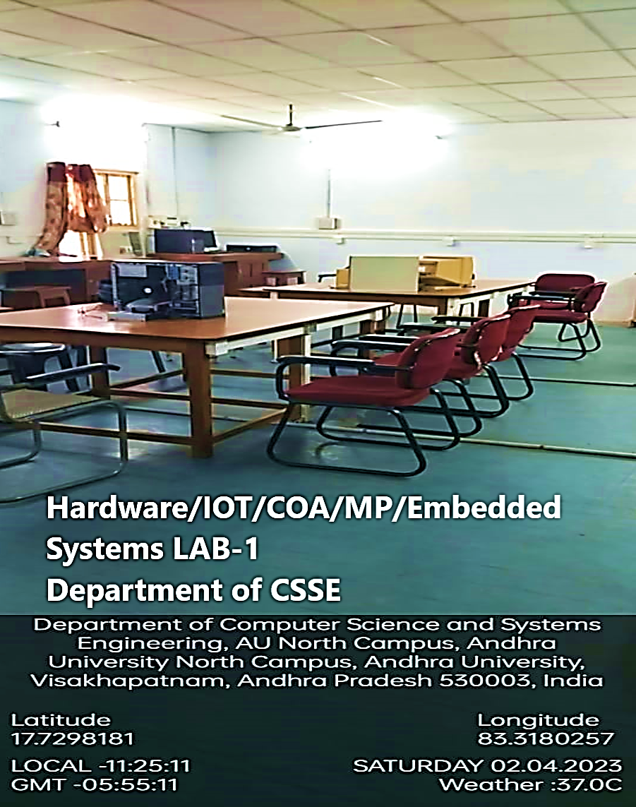
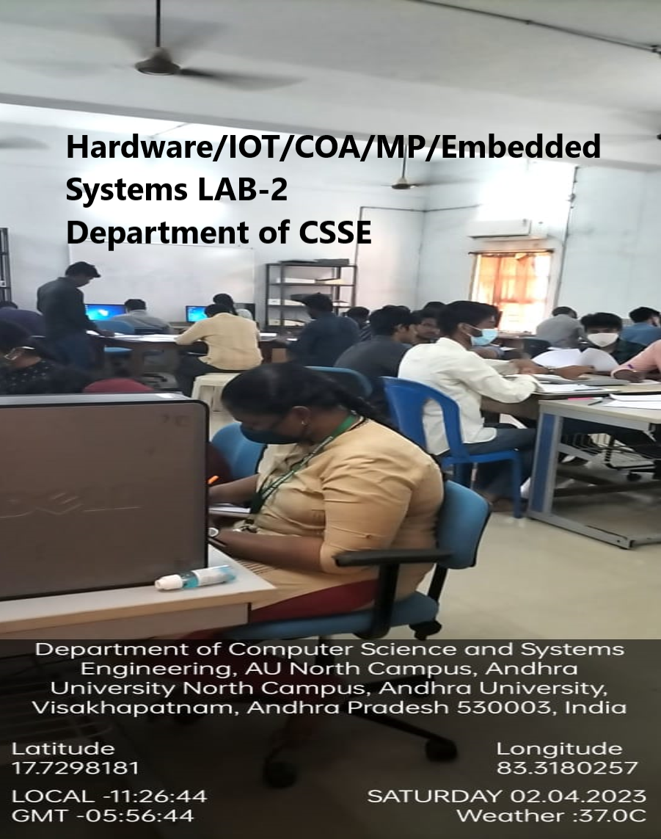
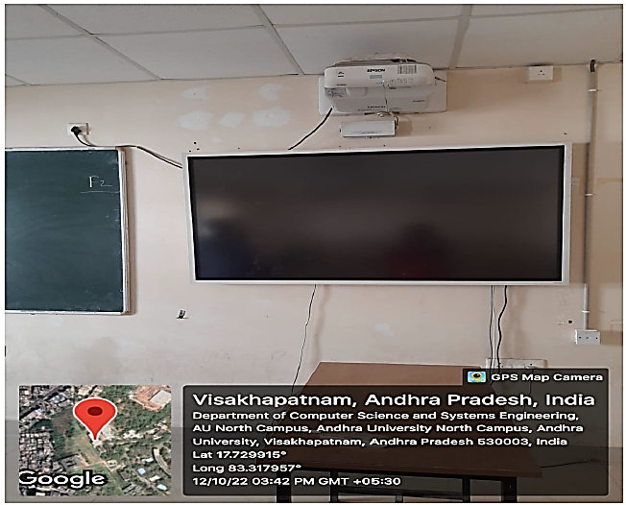
Infrastructure
Lecture Halls
Hardware Labs

Slide 48
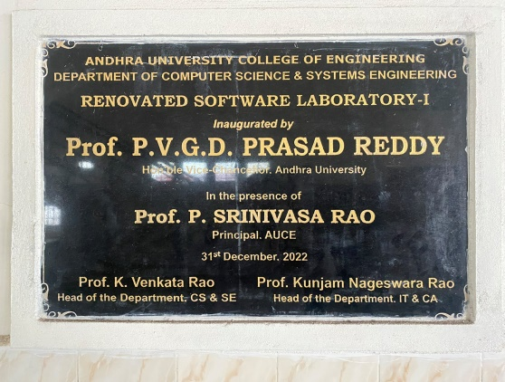
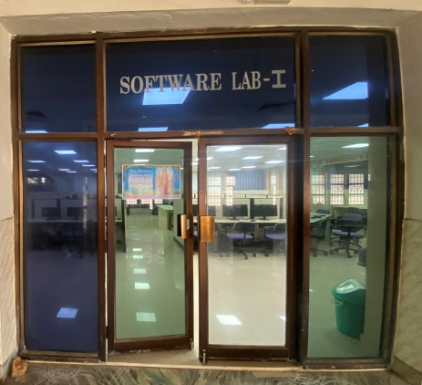
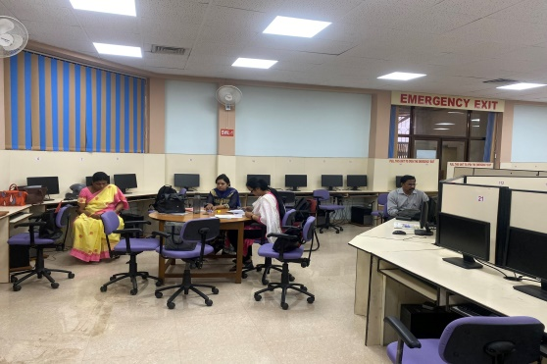
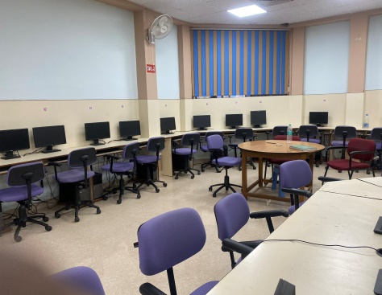
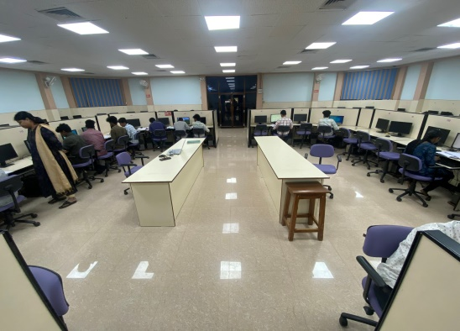
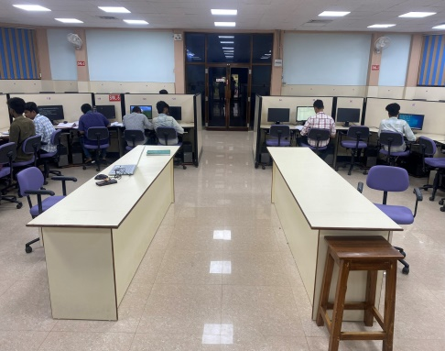
Software lab-1
Renovation of Softwarelab-1 in Nov-Dec,2022.
S. No. | No. of Systems | System Configuration
1 | 80 | Intel(R)Core(TM)2 Quad CPU Q8200 @2.33GHZ, 4GB Ram, 500GB HDD
2 | 20 | Intel(R)Core(TM) I7-8700CPU@2.33GHZ 8GB Ram, 1TB HDD
3 | 18 | Intel(R)Core(TM) I5-4590CPU@3.30GHZ 8GB Ram, 1TB HDD
4 | 6 | Intel(R)Core(TM)2 Quad CPU Q8200 @2.33GHZ 2GB Ram, 500GB HDD

Slide 49
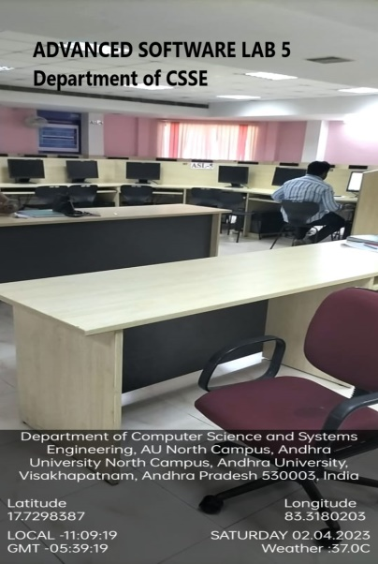
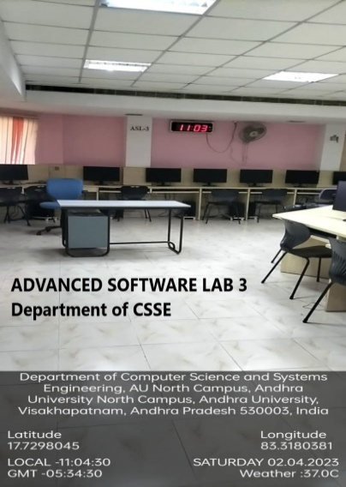
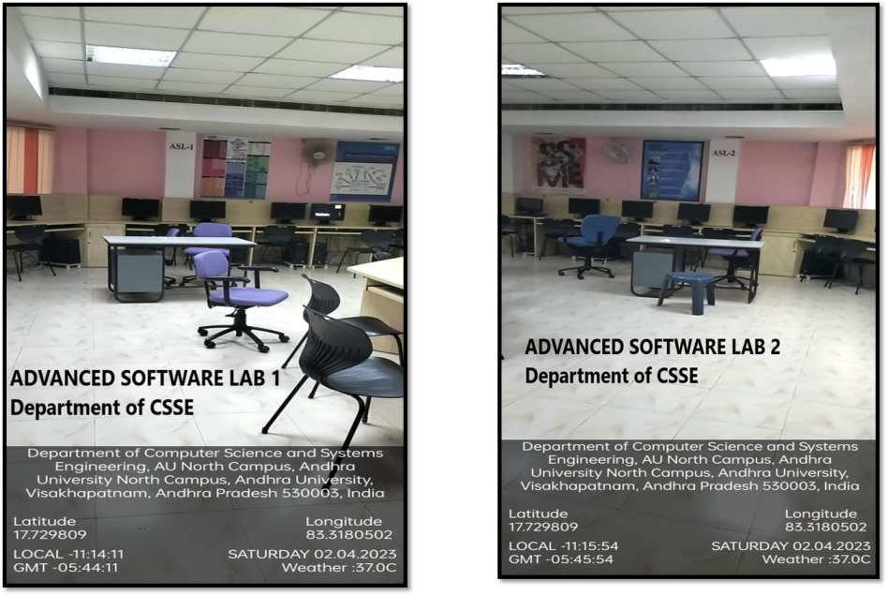
Software lab-2
Infrastructure
S. No. | No. of Systems | System Configuration
1 | 80 | Intel(R)Core(TM)2 Quad CPU Q8200@2.33GHZ 4GB Ram, 500GB HDD
2 | 20 | Intel(R)Core(TM) I7-8700CPU@2.33GHZ 8GB Ram, 1TB HDD
3 | 4 | Intel(R)Core(TM) I5-3470CPU@3.20GHZ 4GB Ram, 500GB HDD
4 | 6 | Intel(R)Core(TM)2 Quad CPU Q8200@2.33GHZ 2GB Ram, 500GB HDD
5 | 2 | Intel(R)Core(TM) I5-4590CPU@3.30GHZ 8GB Ram, 1TB HDD
6 | 11 | Intel(R)Core(TM)2 Quad CPU Q8200@2.33GHZ 4GB Ram, 160GB HDD
7 | 1 | Intel(R)Core(TM)2 Quad CPU Q8200@2.33GHZ 8GB Ram, 500GB HDD

Slide 50
New Equipment / Infrastructure Augmented during the Assessment Period
Academic Year | New Equipment for Software and Hardware Labs
2023-24 | 100 Computers- Intel(R)Core(TM) I7-12th Gen, 16GB RAM, 1TB HDD, 4GB Graphics Card.
2021-22 | 65ah 12v SMF batteries, 600v Abliebort UPS, dell OptiPlex 7090MTtower desktops(3) HP Deskjet 419 All-in one printer, HP LaserJet 108a Printers(4), APC 600 VA UPS (5) 65ah 12v SMF batteries(80), 26ah 12v SMF batteries(15), 100ah 12v SMF batteries(16) 600 VA UPS (16), Yoga Duet 7i Gen6 Tablet Intel I-5 10th Gen Laptops(2) 10 no's - Digital IC Trainer kit Basic Gates, Bread Boards with clock pluses, Banana Patch Wires, 4 no’s of (Adder & Subtract trainer kits, 4-bit binary adder trainer kits, Multiplexer & DE multiplexer kit, decoder kit, flip flop trainer kit, shift register trainer kit, Counter trainers kit, BCD adder trainers kit), Decode counter trainer kits(4), Bundle breads(4), 8085 Microprocessor Trainer Kits(10), DC Power Supply Machines(10).
2020-21 | 40 Computers -Intel(R)Core(TM) I7-8700CPU @2.33GHZ, 8GB RAM, 1TB HDD.

Slide 51
Library and e-Resources
Name of the Publisher | Resources | Link of Access
IEEE | Dr.V.S.Krishna Library self-supported E Resources | IEEE Xplore
Delnet | Delnet.in | Search Home (delnet.in)
NATIONAL DIGITAL LIBRARY | NDL e-Resources | National Digital Library of India (iitkgp.ac.in)
J-Gate | E-Shodhsindu | Login Page (jgateplus.com)
N-List | E-Shodhsindu | https://ess.inflibnet.ac.in/eres.php?memID=2
ACM Digital Library | The world’s largest educational and scientific society, uniting computing educators, researchers and professionals to inspire dialouge, share resources and address the field’s challenges | https://dl.acm.org/do/10.1145/institution-60075905/full/
Knimbus | Knimbus mLibrary is a one-stop solution with rich features to build a powerful and user friendly digital library through which users can seamlessly access the digital resources anytime, anywhere and on any device. | https://www.andhrauniversity.edu.in/library.html
Library and e- Resources
Total Number of Books in Dept. of CS&SE :2,157
Total Volumes: 72
Reference Books: 14
SC & ST Book Bank:-
E-BOOKS :http://community.ebooklibrary.org/?AffiliateKey=WEL-ColEngAndUni
National Journals:2
International Journals : 3
NPTEL Videos (web & Video Lectures)-
Additional information
https://andhrauniversity.edu.in/library/icons1.html
https://services.andhrauniversity.edu.in/filestorage1/iqacfiles/onlineservices.pdf
https://services.andhrauniversity.edu.in/filestorage1/iqacfiles/soul-proof.pdf
https://services.andhrauniversity.edu.in/filestorage1/iqacfiles/shodhganga-proof.pdf
https://services.andhrauniversity.edu.in/filestorage1/iqacfiles/Library.pdf
Paste link for additional information
https://scholarkart.in/AU/publications.
Palm leaf Manuscripts – Andhra University Digital Library (scholarkart.in)

Slide 52
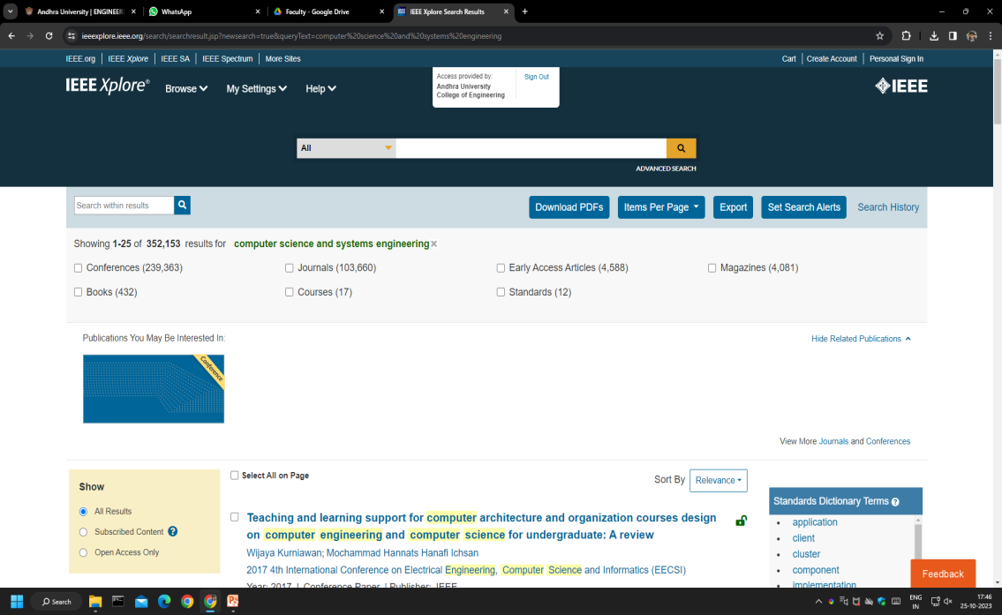
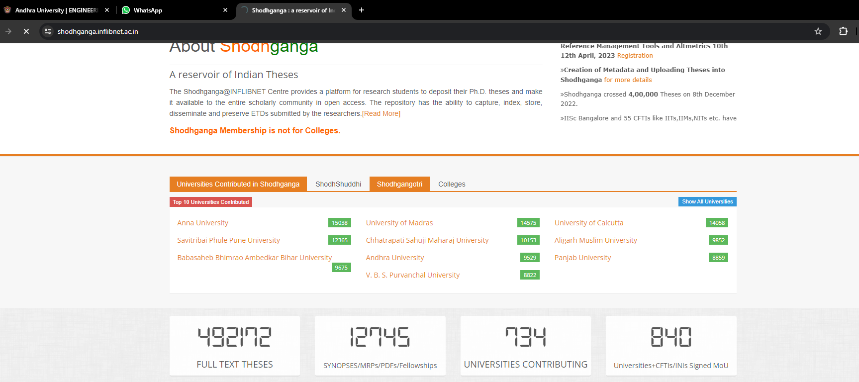
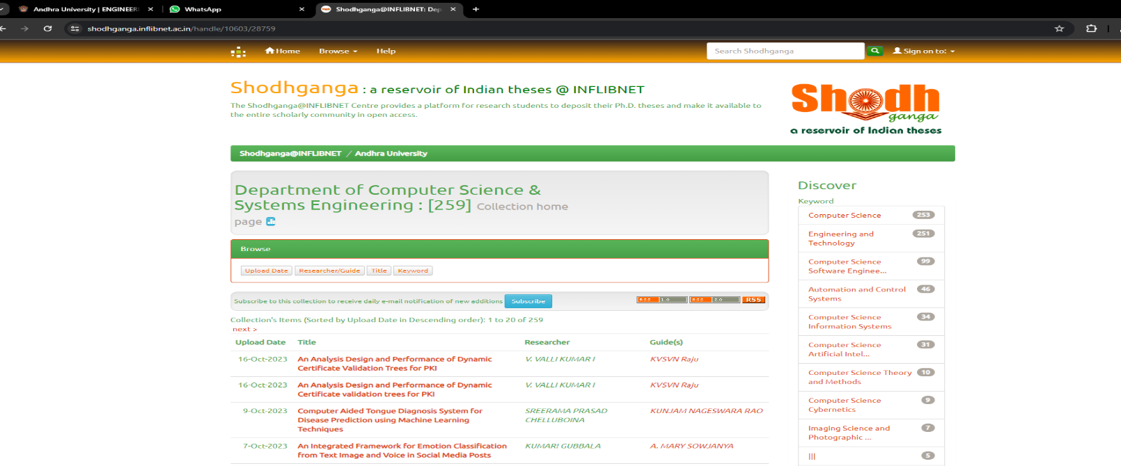
Library and e-Resources

Slide 53
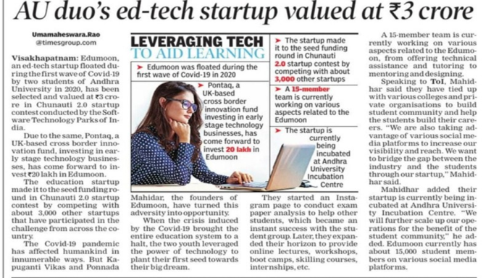
Innovation, Incubation & Startups
Student participation and leadership
Led the OWASP (Open Web Application Security Project) chapter for Vishakhapatnam
Led the coding club at Edumoon
Organized the periscope hackathon in AUCE
Organized top-200 hackathon for Gitam university
Conducted and spoke at the "Web-dev" with chatgpt seminar at ANITS
Conducted two 30-day coding challenges at AU
Conducted web-dev for beginners (Thrice, once paid and the other two free)
Represented Edumoon at the GDSC dev fest 2022
By K. Vikas and P. Mahidar

Slide 54
Innovation, Incubation & Startups
Fly Nexus Drone Innovation
Guarantees precise and stable flight performances
Stunt experience/aerial photography with RTL (return to launch)
Acrobatic maneuvers
14-20 minutes time / handles upto 25 kmph-40 kmph winds for stunts and aerial imagery.
6-flight modes which are customizable.
Designed and developed by G. Charan Venkatesh,
G. Nischay and N.U.S.S Abhinav from 3rd year-
B.Tech CSE

Slide 55
Innovation, Incubation & Startups
Significant Scientific Innovations by Prof. P. Seetharamaiah
ROBOTIC ARM AND HAND
DST Funded
BIONIC EAR
DRDO: NSTL/DEBEL Funded
Transcutaneous RF Link between External Speech Processor and Internal Implantable medical device:
cochlear implant.
A Flexible Easily Controllable Robot Arm and Four Fingered Robotic Hand

Slide 56
Innovation, Incubation & Startups
DIGIFAC
Imparting skills in Lowcode technologies
Enhancing employability skills in students
Providing Job opportunities

Slide 57
Innovation, Incubation & Startups
ā hub
In 2021, the Honorable Vice Chancellor of Andhra University, Prof. P.V.G.D.Prasad Reddy thought of promoting innovation in the University.
ā hub is a thriving center of entrepreneurial activity housing 90+ startups and businesses and providing direct employment to over 500 people
ā hub will have a total of 2,00,000 square feet of space spread across multiple buildings and fields

Slide 58
Holistic Student Personality Development Activities
Games and Sports
Gymnasium
Yoga

Slide 59
Student Clutural Activities
Cultural Events

Slide 60
Student Council and Activities
Anti Ragging Week
Republic Day/Independence Day Celebration
Swachh Bharat

Slide 61
Student Council and Activities
D.O.E:01-10-2016
Events: 04
Participants: 150
Debates, Elocution, Writing Competitions, Micro Tales
DOE: 28-07-2018
Events: 5
Participants: 2000
Fest, Flash mobs, Music & Dance Workshops, Technical & Cultural Events
Communicons
AU United Cultural Club
GITA (General Interest Topics Avenue)
GSDC (Google Student Developer Club)
DOE: 20-12-2020
Events: 4
Participants: 600
Tech Innovations, Patriotic Events, Free Tuitions
DOE: 09-10-2020
Events: 14
Participants: 2500 (online and offline)
Hackathons, website development, resume building, android programming and coding challenges etc.

Slide 62
Student Council and Activities
Teachers day Celebration

Slide 63
Student Council and Activities
Departmental Day

Slide 64
Student Council and Activities
Periscope-2022
National Level Conference

Slide 65
Student Council and Activities
Ethnic Day

Slide 66
Other Facilities Provided in the Department
RO Plant
Canteen
Open Air Auditorium
Garbage Bins
Ladies Waiting Hall

Slide 67
Best Practices
1. Up-Skilling in emerging areas of computer science and engineering
UG/PG Students and research scholars have undergone certification programmes offered by national and international learning platforms such as Swayam-NPTEL, Coursera and Microsoft.
Continuous learning by the faculty in the emerging technologies to keep pace with curriculum revision from time to time is in place.
S.No | Name of the learning platform | No. of students | No. of Faculty
1. | Swayam-NPTEL | 360 | 10
2. | Microsoft Up-skilling programme | 590 | 13
3. | Coursera | 450 | 16

Slide 68
Best Practices

Slide 69
Best Practices
Active participation of students in enhancing their coding skills by participating in coding competition and hackathons.
K. Kiran Kumar and Ch. Hemanth 4th B.Tech-CSE students undergoing paid internship in gny.ai startup
T. Vinay Kumar and Raghvendra Varma 2nd year B.Tech-CSE students have developed website for ā-hub (www.a-hub.co)
40 students from 2nd ,3rd & 4th B.Tech - CSE have been undergoing year long internship on latest technologies at ā-hub

Slide 70
Best Practices
The department has conducted Internal Hackathon for Smart India Hackathon 2023 (SIH2023).
250 students forming 42 teams have participated.
Problem statements of 34 teams are uploded to SIH portal for All India grand finale competition to be conducted by MHRD, Govt. of India
‹#›

Slide 71
Best Practices
2. Dream Wall : “Unfold Your Story”
The Honorable Vice Chancellor Prof. PVGD Prasad Reddy has envisioned a thematic Dream Wall depicting the scientists and industry leaders to inspire budding engineers to rise to prominence in their chosen field of interest.

Slide 72
Best Practices
3. Environmentalism
Tree Plantation
Rain water harvesting Pond and pits
e-waste management

Slide 73
Progressive Plan
Nurturing students to become leaders to head and inspire academic institutions and industry
Leadership
Ideating entrepreneurship and start-up culture through a-hub ,DIGIFAC,AU skill development centre
Entrepreneurship
Promoting Research and development culture among students, scholars and faculty
Research Culture
Preparing industry ready students through internships, interaction with alumni from industry
Employability Skills
Fundamental and applied research activity to solve industrial and societal problems
Societal Empathy
Imparting communication and managerial skills, organizing seminars, workshops and student exchange program for wholesome personality development
Personality Development
Teaching-Learning process augmented with e-learning resources: Industrial visits to understand and fill the gaps between theory and practice: Honours/Minors in the curriculum to promote advanced and multi disciplinary approach
Engineering acumen

Slide 74
Department of Computer Science and Systems Engineering

